Slide 1
Creative Arts – Dance
Year 9 and 10

Slide 2
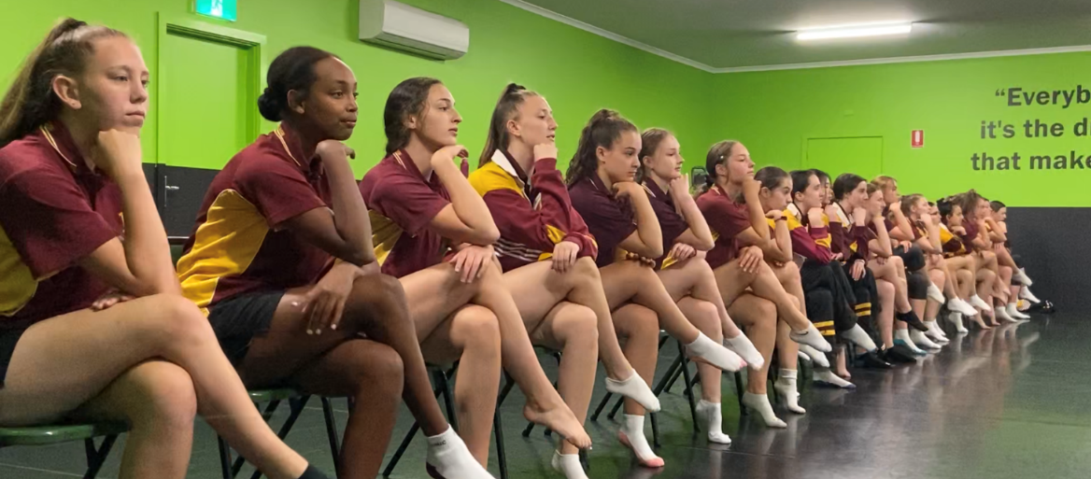
Dance
Our partnership with Jenina’s Dance Workshop, one of Hobart’s premier dance studios, ensures that our students have access to the best instructors and facilities possible. Expert dance teachers share their knowledge, giving our students an excellent, professional dance experience.
The Year 9/10 Course assumes students are experienced in Dance and interested in continuing in Years 11 and 12.

Slide 3
What do you do?
Build upon the skills developed in Year 8.
In depth exploration of dance techniques, including Classical, Ballet, Contemporary, Jazz, Hip-Hop and Lyrical.
Creating, developing and performing original choreography.
Present work at the Southern Tasmanian Dance Eisteddfod and Showcase events at the College.
Dominic’s Year 9/10 Dance Program ensures that students are prepared with the skills and knowledge required for Senior Secondary Dance curriculum in Years 11 and 12.

Slide 4
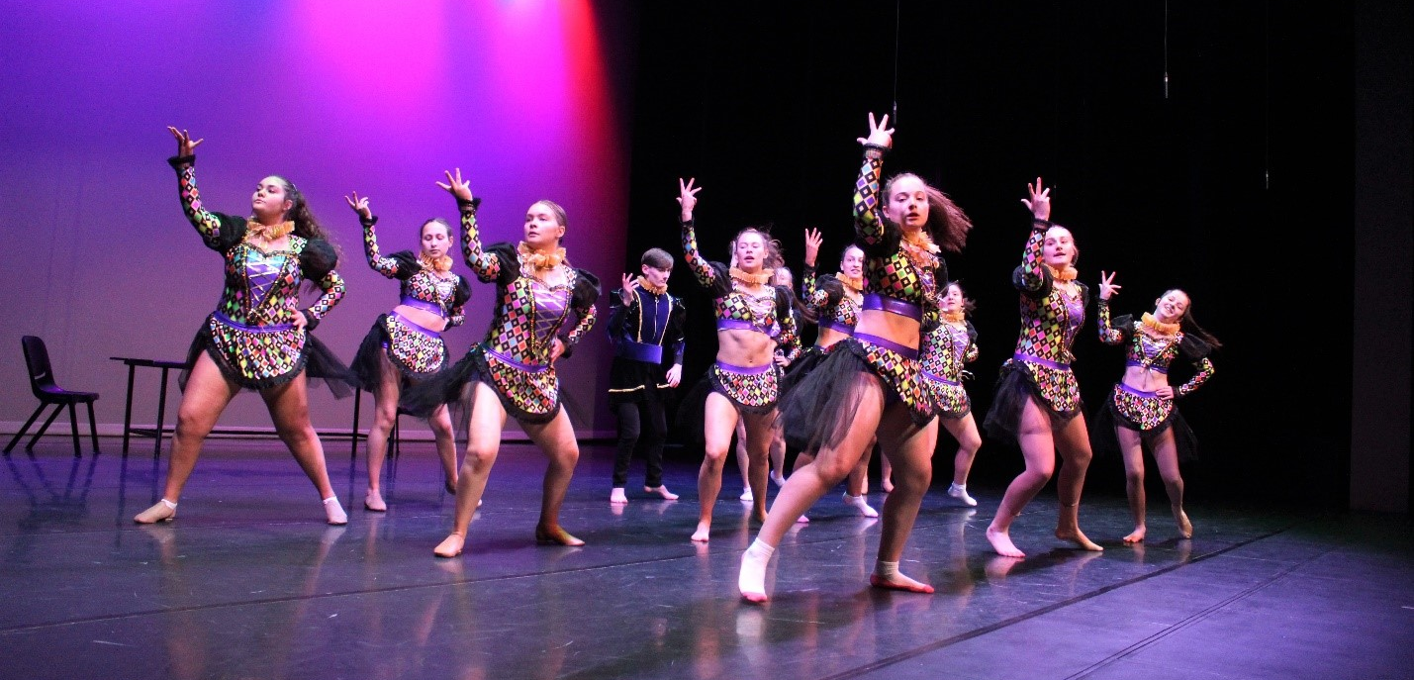
What you need?
Sports uniform.
Jazz shoes.
Energy and enthusiasm.

Slide 5
Find out more…
Please feel free to contact Mr Mike O’Brien, Head of Creative Arts, at mobrien@dominic.tas.edu.au

